Slide 1
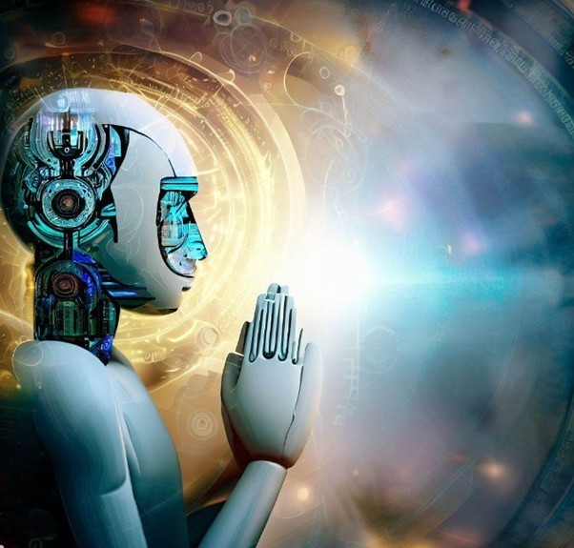

AI, Humanity and God
Graham Budd
Executive Director, The Faraday Institute for Science and Religion
Notes:
Hello everyone. Good to be back here. Last at Eden late 80s when undergrad. Thanks for hosting today.

Slide 2


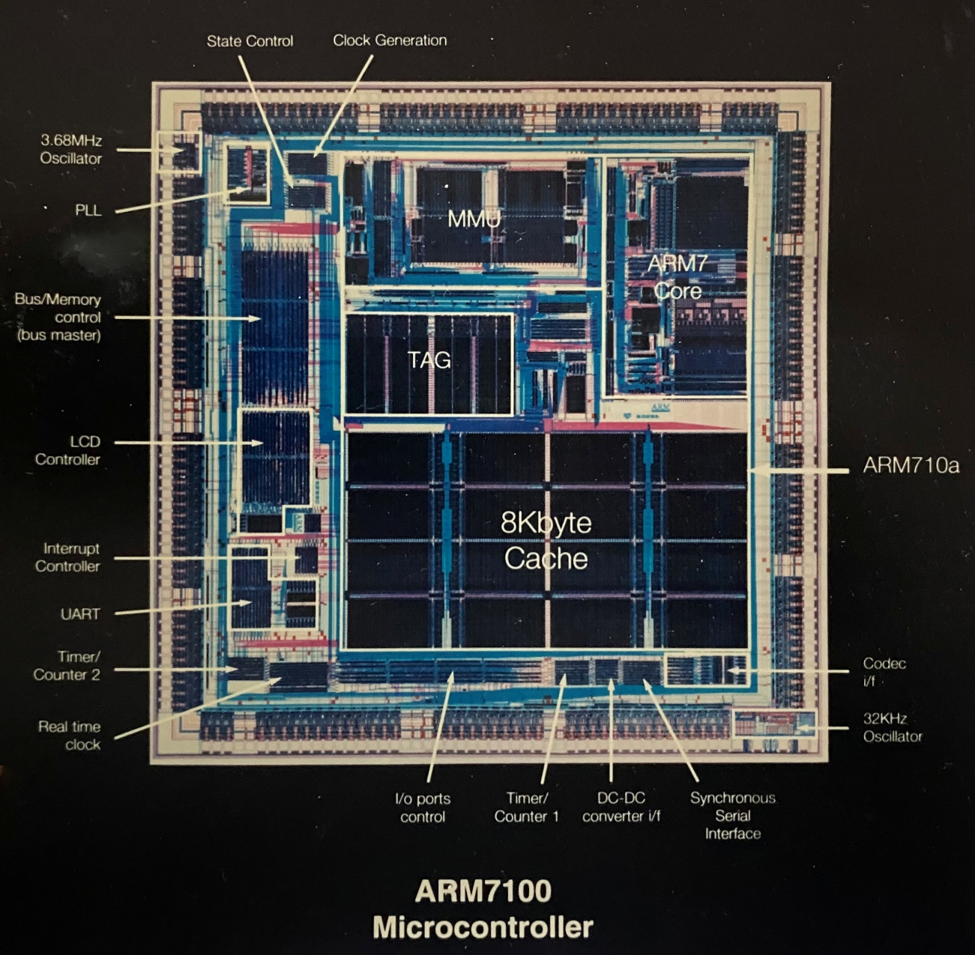
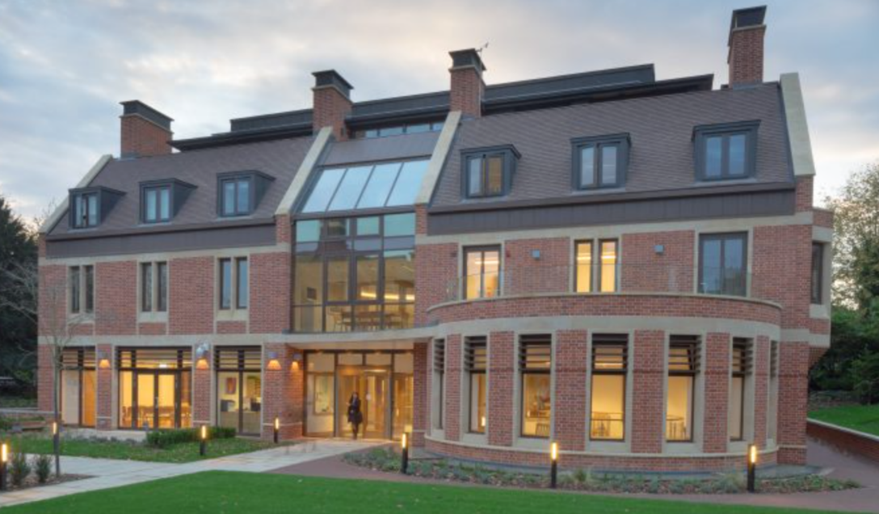
AI
This Photo by Unknown Author is licensed under CC BY-NC
Notes:
So, given my background as an Engineer, you won’t be surprised that I’m broadly an optimist about technology and seeking ways to use it wisely and for the common good.
I’ve always seen my work generally as part of my calling as a Christian, but now * at the Faraday Institute, it’s great to be able to look at the impact of AI from a Christian perspective specifically as part of my role!
Technology is never neutral: it takes on the characteristics of those who devise, finance, regulate and use it.
And AI is a technology which will have extreme impact on society and humanity.
…......... Things that seemed like Sci-Fi a few years ago are becoming real, fast.

Slide 3



“90% certain that AI will reach the level of a country-full of geniuses in one data centre in a few years”
More than 80% of Anthropic’s code now written by AI
  Dario Amodei
  CEO Anthropic
Warning of misaligned superhuman AI and bioterrorism
This Photo by Unknown Author is licensed under CC BY
Notes:
This is Dario Amodei, CEO of Anthropic, one of the big three AI foundation model providers. A few weeks ago, he said he was “90% certain that AI will reach the level of a country-full of geniuses in one data centre in a few years”. Big tech leaders prone to make such pronouncements because it helps hype up their products. But the pace of development in AI really is incredible.
More than 80% of Anthropic’s code is now being written by AI – by itself. Philosophers of technology have been talking for years about the risks of recursive self-improvement. But now we’re getting close, and Anthropic are sounding the alarm.
He also warned that misaligned superhuman AIs and bioterrorism enabled by AI are dangers for which no effective governance structure yet exists. It’s unusual for a tech giant to be warning society about its own products.

Slide 4



AI Chatbots
“The AI Backlash” – The Economist (27 June 2026)
Activism stopping data centre projects worth $100Bn
40% of voters want AI banned from all industries
AI speakers heckled at graduation ceremonies
Notes:
I assume most of us here use AI chatbots like these.
Trained from vast datasets of human knowledge and language, we know they appear incredibly eloquent, wise and human-like in their responses, with apparent feelings and emotions.
AI chatbots are designed to simulate personhood, to engage our attention, playing on our anthropomorphic tendencies, to get more data to improve their training and create monetizable opportunity.
Misunderstanding AI can have serious consequences: from lawyers losing their jobs after using non-existent case info from AI, to serious mental health delusions or even suicide where people are drawn into addictive pseudo-relationships with AI chatbots.
When I opened my copy of the Economist this w/e one of the leaders was on “the AI backlash”. We are starting to see a public backlash to AI, especially in the US. Driven by fear that AI is going to take all of our jobs. Fear of autonomous AI weapons, and AI companies own warnings.
Here is some of the data and things we’ve seen happening recently, like the heckling of those advocating for the benefits of AI.
What do we make of all of this? What is the real nature of this AI? What does it mean for society and for our understanding of being Human? How should we respond wisely, from a Biblical perspective?

Slide 5
Agenda
The Nature of AI
Implications for AI and Humanity of Contrasting Worldviews
Christian Responses to AI
Notes:
In order to shed some light on these questions I want to look at three main areas today.
First of all we’re going to look at the nature of AI. To respond wisely to AI, it’s really important to understand what AI really is and how it works. For the IT experts in the room – please bear with me during this section for the benefit of those who are not experts!
Then for the second part we’re going to look at contrasting worldviews including a Biblical perspective, and the implications of this for our understanding of AI.
Finally we’ll consider some ideas on Christian responses to AI: We’ll look a bit at ethics but I’m mainly going to use the example of the impact of AI on employment.
The idea throughout is to stimulate thinking about this: explore further in the Q&A!

Slide 6
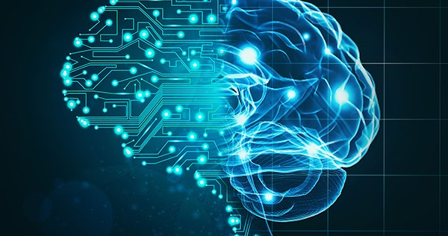
AI Definitions
This Photo by Unknown Author is licensed under CC BY
Oxford English Dictionary: “The application of computer systems able to perform tasks or produce output normally requiring human intelligence, especially by applying machine learning techniques to large collections of data”
IBM: “Artificial intelligence (AI) is technology that enables computers and machines to simulate human learning, comprehension, problem solving, decision making, creativity and autonomy”.
Notes:
OK let’s go into the first section…
There are lots of definitions of AI. Combining these two is a pretty good summary.
From the OED definition here, I want to pick out the focus on Machine Learning because that’s what today’s AI really is.
- And from IBM’s definition – to note that AI is a simulation of intelligence.

Slide 7
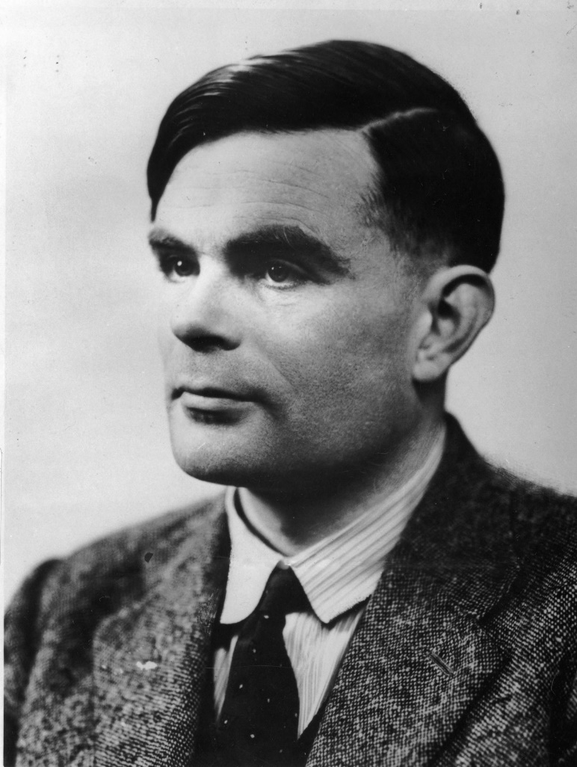
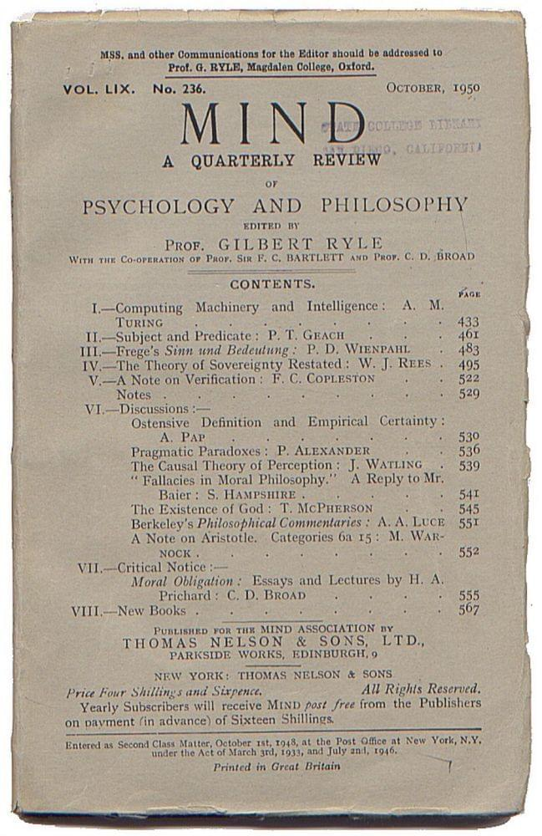
The AI Journey
1943: Sci-Fi - Asimov’s “I Robot” and 3 laws of robotics
Ancient philosophical ideas
1940
1960
1980
2000
2020
Enlightenment & emergence of modern science
1950
1970
1990
2010
1950: Alan Turing – machines that think and the “Turing Test”
1920: Sci-Fi - “Robot” first used for intelligent machine
This Photo by Unknown Author is licensed under CC BY
Notes:
Let’s look briefly at how we got here.
You can trace AI back to early philosophical ideas on the nature intelligence, and then through the enlightenment, robots and early sci-fi writing and films, but for the idea of machines that think, we come to Alan Turing: often called the grandfather of AI because he laid the conceptual and philosophical groundwork. He published his famous paper on “Computing machinery and intelligence” in 1950, including what became known as the Turing Test: a way to assess whether a machine could think (which research shows we have now passed!).

Slide 8
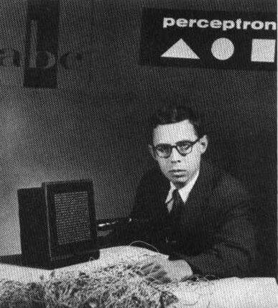
The AI Journey
1943: Sci-Fi - Asimov’s “I Robot” and 3 laws of robotics
1956: “AI” term first used – John McCarthy
Battle of differing approaches: reason or neuroscience
Ancient philosophical ideas
“Symbolic” AI – based on reason/logic
1940
1960
1980
2000
2020
Enlightenment & emergence of modern science
1950
1970
1990
2010
Hope, hype and disappointment – “AI Winter”
1950: Alan Turing – machines that think and the “Turing Test”
1920: Sci-Fi - “Robot” first used for intelligent machine
1958: Perceptron – ancestor of neural networks
This Photo by Unknown Author is licensed under CC BY
Notes:
Modern AI research began later in the 1950s, and the term “Artificial Intelligence” was first used by John McCarthy in 1956 when a group of computer scientists got together at Dartmouth in New York to found a new field of research into AI.
Different approaches tried, based on neuroscience or reason/logic. An early system drawing on neuroscience was Frank Rosenblatt’s Perceptron, created for the US navy in 1958. which used a neural network.
But that approach didn’t get traction – it needs lots of data and there wasn’t much useful data around. * Instead the reason/logic approach called “symbolic” AI formed the basis of AI R&D for the next 40 years.
This wasn’t very successful. and a cycle of hype and disappointment: “AI winter”.

Slide 9
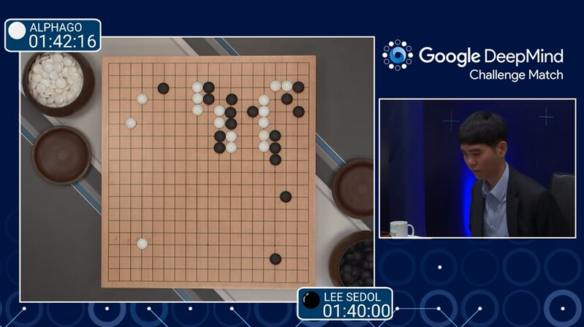
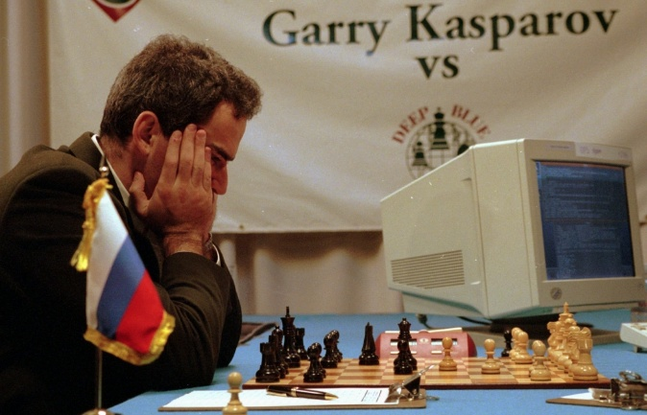
The AI Journey
2016: AI beats world Go champion
1997: AI beats world chess champion
2018-Generative AI
Chatbots
1943: Sci-Fi - Asimov’s “I Robot” and 3 laws of robotics
1956: “AI” term first used – John McCarthy
Battle of differing approaches: reason or neuroscience
This Photo by Unknown Author is licensed under CC BY-SA-NC
This Photo by Unknown Author is licensed under CC BY
Ancient philosophical ideas
“Symbolic” AI – based on reason/logic
1940
1960
1980
2000
2020
Enlightenment & emergence of modern science
1950
1970
1990
2010
Hope, hype and disappointment – “AI Winter”
The data age: Machine Learning finally comes of age!
1950: Alan Turing – machines that think and the “Turing Test”
1920: Sci-Fi - “Robot” first used for intelligent machine
1958: Perceptron – ancestor of neural networks
Notes:
The greatest achievement for the “symbolic” approach was IBM’s Deep Blue AI beating the world’s #1 Gary Kasparov at chess in 1997.
But then by 2000 we had the internet, cell phones and mobile computing. These changed everything by providing the foundation for a new data driven economy, providing the data needed for machine learning algorithms. So investment poured into neural networks and machine learning research.
The power of this was demonstrated in 2016 when DeepMind’s AlphaGo beat the world’s top Go player Lee Sedol – this game was previously thought to be beyond the reach of AI. Machine Learning allowed Alpha Go to learn by playing itself millions of times.
Then in 2018 the Transformer architecture and Large Language Models were invented which enabled chatbots to really take off.
- So now all of today’s AI systems, including your favourite chatbot, are based on Machine Learning using Neural Networks.

Slide 10
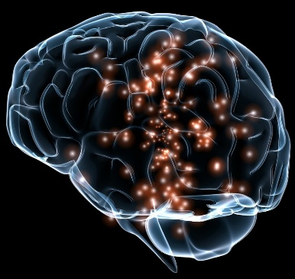
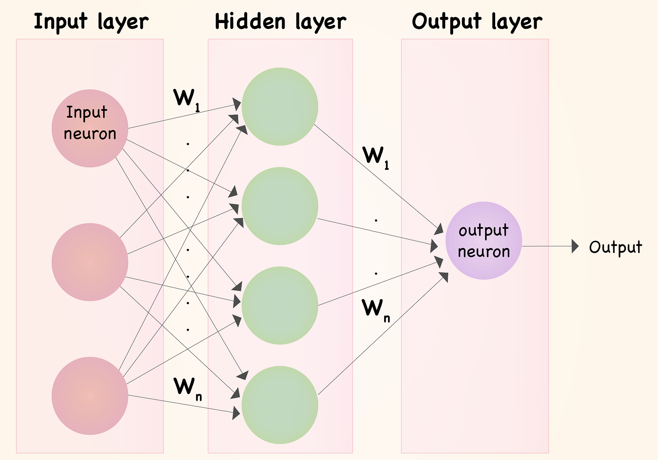
Neural Network
INPUT DATA
OUTPUT PREDICTION
This Photo by Unknown Author is licensed under CC BY-SA-NC
This Photo by Unknown Author is licensed under CC BY-SA
Notes:
* Here’s a simple neural network: it has nodes which are like neurons in the brain, and connections between them which are like synapses in the brain. Each of the input connections has an associated adjustable “weight” (the Ws) which is a value which determines how much influence that connection has in determining the output of the node.
- The maths of it is quite simple really. To get the output, you multiply each input value by the weight for its connection, and add all those together, then rescale the output to be suitable to feed as an input to the nodes in the next layer. That’s it. In a complex AI foundation model you might have billions of weights and do millions of these calculations in parallel.
- To train the neural network, you can adjust the weights to predict the right output for different inputs.
- We can illustrate how this works with one of the initial successful applications for machine learning - for image recognition.

Slide 11
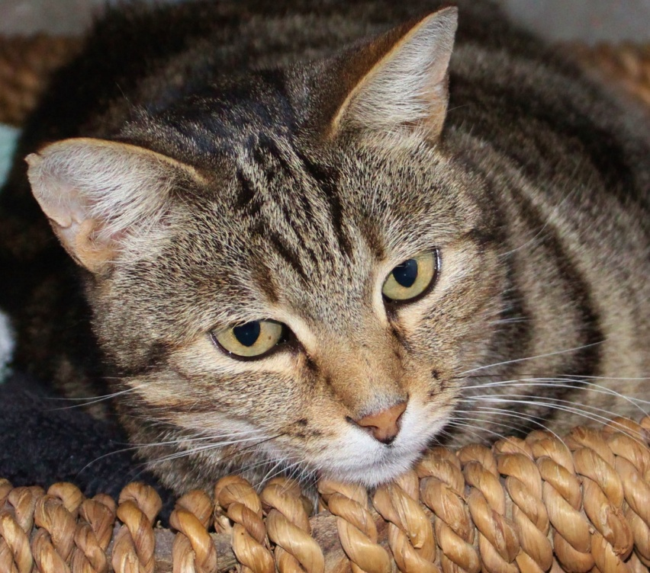

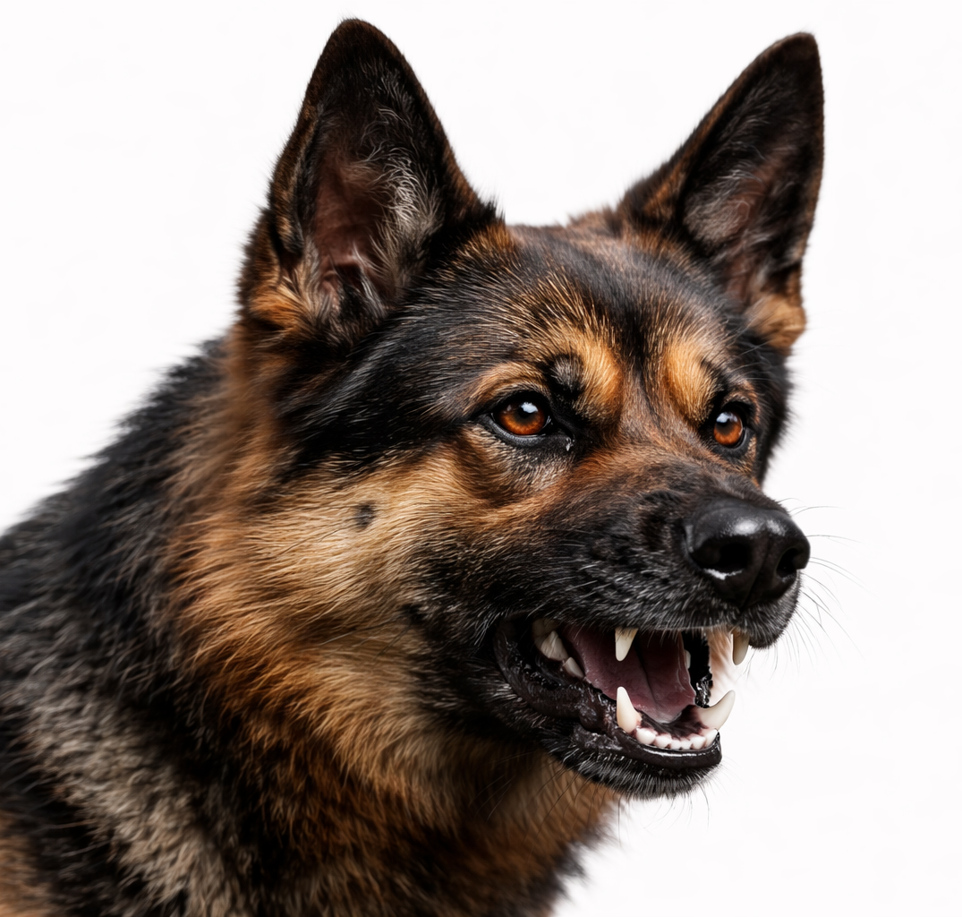

Notes:
So the task here is we want to train a neural network to be able to identify whether a new, previously unseen image is a cat or a dog.
Simple task for humans, but remarkably difficult for a machine.

Slide 12
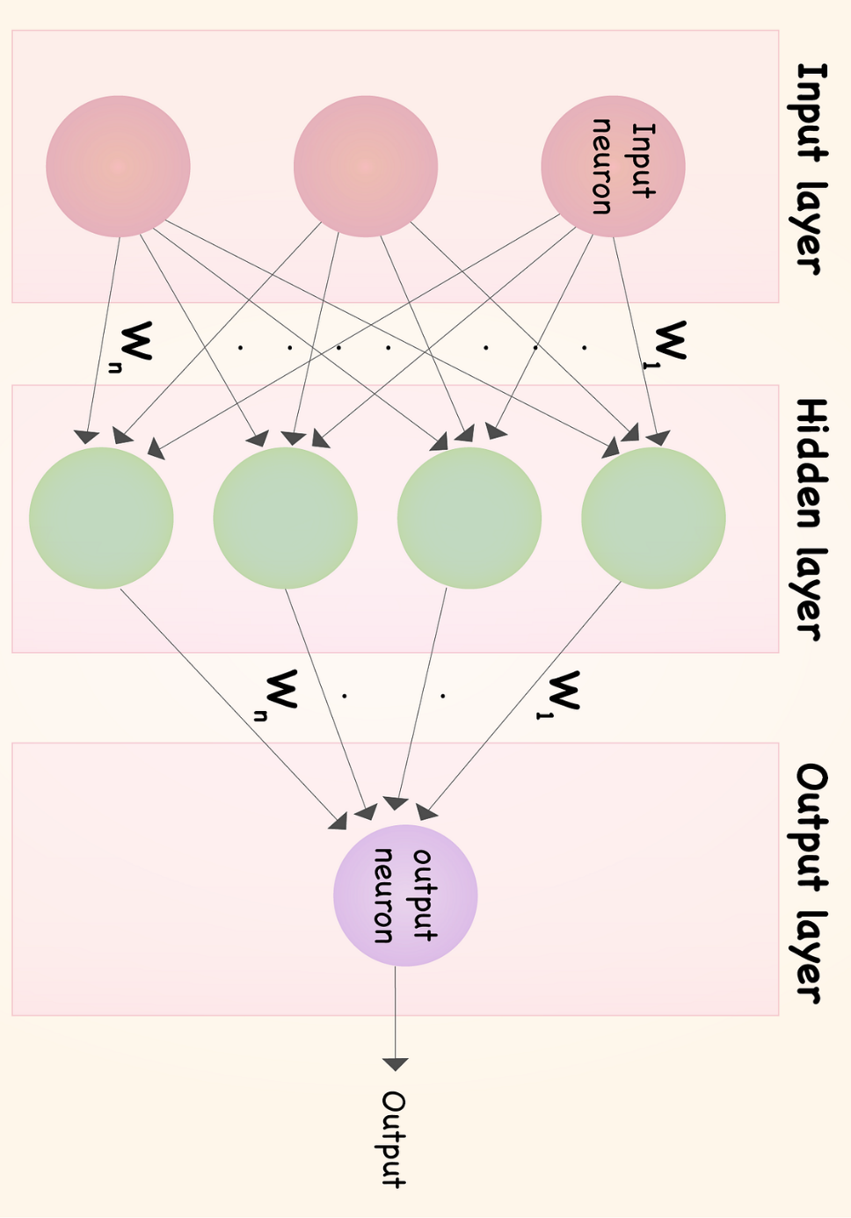
TRAINING
INFERENCE
Untrained Neural Network
This Photo by Unknown Author is licensed under CC BY-SA
Notes:
* Rotate our neural network, and add a few layers, here it is.

Slide 13

TRAINING
INFERENCE
Untrained Neural Network
Cat
Gradient Descent
Algorithm to minimise difference between predicted & actual output
Acts like a sculptor – gradually adjusting weights to reduce errors over time
Dog
Cat
Notes:
We have an untrained network with random weights. Let’s start to train it.
Picture converted into a set of numbers that the computer can understand, and those are fed into the network inputs at the top, we also provide the label to go with the image.
Run the algorithm – compare with the label - wrong answer! We need to train the model to do better next time.
We do that by adjusting the weights, which uses a technique called gradient descent to try and minimise the error in the output. Gradient descent is like an algorithm to minimise difference between predicted & actual output. Think of it like a sculptor – gradually adjusting weights to reduce errors over time.
The width of the connecting lines shows the relative weights.
- OK – we have now done a first training step. It now gets the right answer.

Slide 14
TRAINING
TRAINING
INFERENCE
Untrained Neural Network
Partially trained Neural Network
Cat
Cat
Notes:
* Now we can try again: this time it identifies a different cat correctly. Good.

Slide 15

TRAINING
TRAINING
INFERENCE
Untrained Neural Network
Partially trained Neural Network
Dog
Cat
Notes:
- Now try another image: this time its got it wrong, so we do some more adjustment to the weights, so that it gets it right.

Slide 16
TRAINING
TRAINING
INFERENCE
Untrained Neural Network
Partially trained Neural Network
Dog
Dog
Notes:
After some more training and adjustment of weights, it gets it right.
Now lets try with another dog.
Great, its correctly identified this one.

Slide 17
TRAINING
TRAINING
INFERENCE
Untrained Neural Network
Partially trained Neural Network
Fully trained Neural Network
Notes:
Now imagine we have done this process millions of times with labelled pictures so each time the system can update the weights to do better if it gets it wrong.
- Eventually, you end up with a neural network, or model, which is really well trained to recognise the differences between cats and dogs.

Slide 18

TRAINING
TRAINING
INFERENCE
INFERENCE
Untrained Neural Network
Partially trained Neural Network
Fully trained Neural Network
Cat
Learning from existing data
Applying capability to new data
Notes:
So now we can use that model with pictures that it has never seen before – so it can recognise new images. This is called INFERENCE.
Here we go – let’s try this evil cat – correct!
So once the model had been able to learn from existing data, it could apply that learning to completely new data in the inference stage.
Its all based on probability – statistical inference.
- And that is the basics of how ML works! Remember in reality these networks are much much bigger.

Slide 19
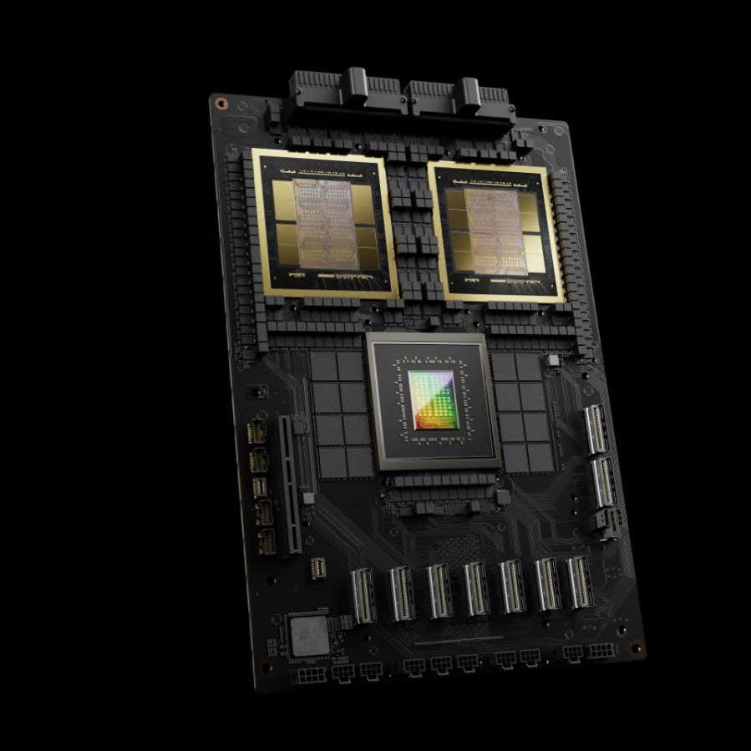

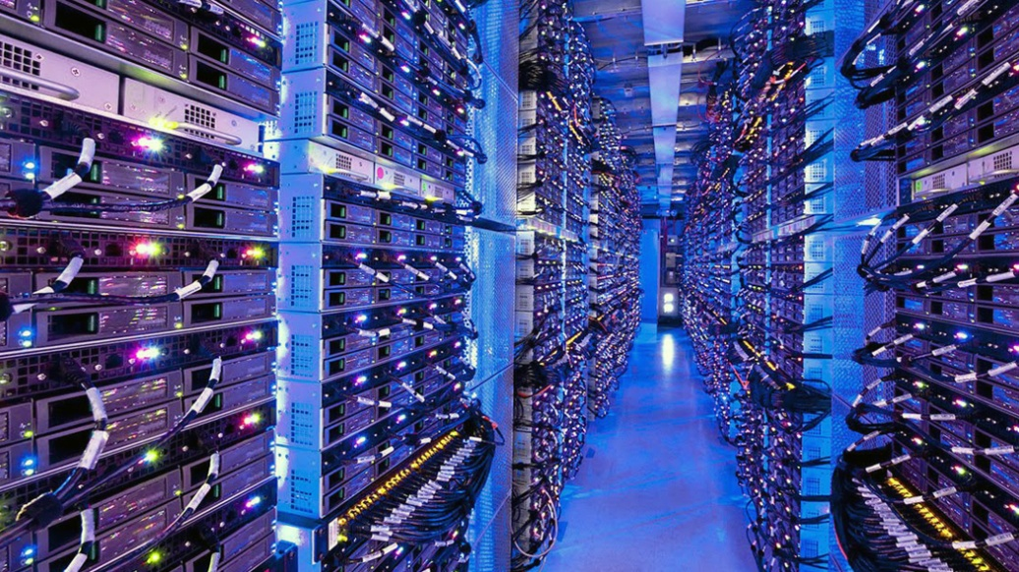
Computing for AI
To compute outputs or weights efficiently in a neural network, need matrix multiplication
GPUs are excellent at matrix multiplication!
This Photo by Unknown Author is licensed under CC BY-NC-ND
Notes:
Now to do this we need to carry out millions of calculations very quickly: to do as much as possible in parallel you need to use matrix multiplications.
- It turns out that a type of processor called a GPU is very good at doing that. These are also what drive the 3D graphics rendering in computer games. These are what fill the world’s data centres.

Slide 20
Large Language Models (LLMs)
A specialist, complex type of neural network
Trained on vast amounts of language data from books, research, internet
Predicts the most probable next word (token) that a human would use
Notes:
Let’s talk about chatbots. These use a more complex type of trained neural network called a Large Language Model or LLM.
An LLM predicts the most probable next word that a human would use in a sentence, using machine learning. The LLM actually works with elements called “tokens” which may be shorter than a word, but I’ll call them words here for simplicity.

Slide 21
LLMs predict the most likely next word in a sequence
Initial input Prompt: What did the cat sit on?
Input Prompt
What did the cat sit on? The
What did the cat sit on? The cat
What did the cat sit on? The cat sat
What did the cat sit on? The cat sat on
Output
What did the cat sit on? The cat sat on the
mat
Notes:
Here’s a simple example. Start with the prompt to the pre-trained LLM: “What did the cat sit on?”. The LLM is going to predict one further word at a time to string onto the end of the sentence. [Press once]
The prompt and output generated so far – is fed back into the model. Each word (token) is converted to a numerical code that the model can work with to do its matrix multiplications.
The specialist combinations of neural networks in the model enables it to take into account the relative meaning of words in its vocabulary, and the context of the words in the prompt, to calculate the most probable next word in the sentence. Billions of matrix multiplications!
This is the clever bit which would take 30 mins to explain - but if you haven’t looked at this before – there are lots of free training videos on YouTube and its well worth getting an understanding of what’s happening. It’s so elegant and clever, and really helps to understand the true nature of what’s going on in these models.
[Keep running through to bottom] Every time it predicts a word, the LLM is actually calculating a probability value for every single one of more than 50,000 words in its vocabulary, in the context of its prompt. (This is one of the reasons this uses so much energy!)
- Then it selects a word with a high probability value. You can program it so it doesn’t always have to be the one with the absolute highest probability: by varying this you can make the model seem more “creative”. But in this case, it is going to be “Mat”!

Slide 22
Training an LLM
Unsupervised Learning -> pre-trained model
desert
a
cactus
grows
in
the
?
Supervised fine-tuning
Smaller, specialised data sets. Adjust weights to provide ideal responses
Reinforcement Learning with Human Feedback
Provide comparisons and let humans choose which they prefer
Notes:
A word on training an LLM. The main step is “unsupervised learning”. Start with untrained model, random weights. Give it some text – vast amounts of it. The model can then train itself by missing out one word at a time and predicting what it is – then using gradient descent to adjust the weights to improve the probability of predicting it correctly next time. Repeat billions of times. Eventually you have a pre-trained model.
Then you can tune the model in more specialised ways, as in the last two boxes here.

Slide 23
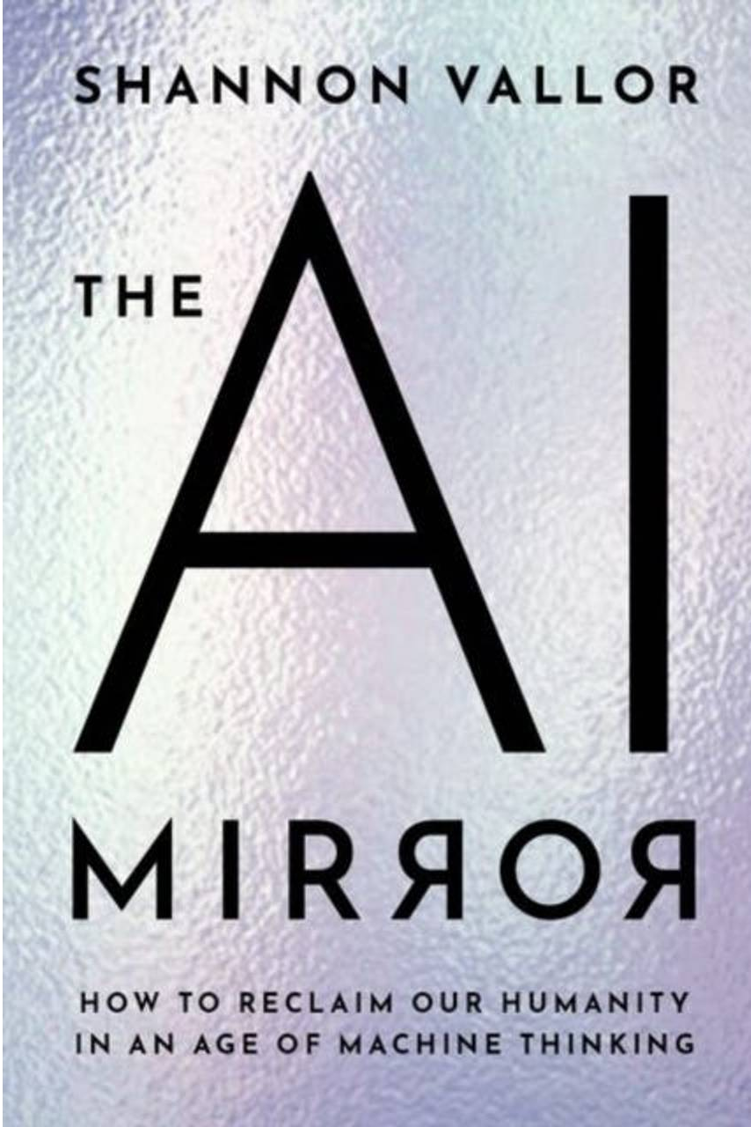
The Nature of AI
LLMs don’t think or reason like humans!
  They are probabilistic machines, pre-trained on huge datasets to predict the next most likely word in a sequence
AI is not an independent mind or autonomous thinker
AI is a powerful, distorted mirror that reflects human data and behaviour back at us
Notes:
So this helps us understand the nature of AI chatbots. As the philosopher Emily Bender said, they are stochastic parrots. All LLM output comes from predicting the most likely next word in a sentence, based on its training data.
Shannon Vallor is a philosopher of technology. In her book “the AI Mirror” she notes that AI is not an independent mind or an autonomous thinker, but a powerful, distorted mirror that reflects human data and behaviour back at us.
But we do also need to recognise that AI’s capabilities are, in a number of ways, “superhuman”. And this is important too in understanding the differences between our humanity and AI.

Slide 24
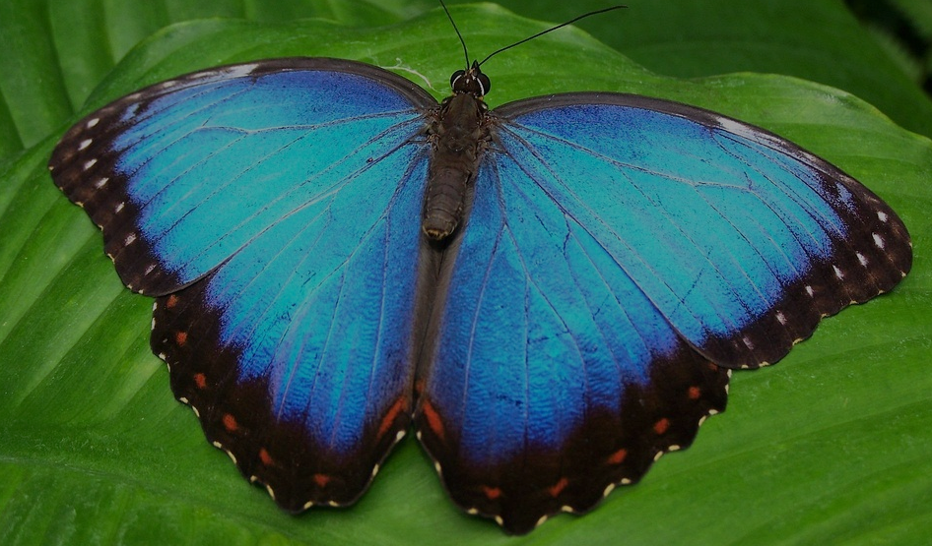
“Superhuman” AI
  Research and write a PhD thesis
  Code an entire website or application
  Act as autonomous agents
“Like the butterfly’s wings, our intelligence can be unwieldy, but like those wings it is also beautiful…. The…. human is defined by vulnerabilities, not capabilities”
Human intelligence
  Constrained by our embodiment
  Limited and unreliable memory
Machine intelligence
  Unlimited bandwidth, storage, speed
Prof. Neil Lawrence (2024) The Atomic Human. London: Allen Lane
Notes:
These chatbots can research and write a PhD thesis in hours rather than years.
They can write code to create entire websites or a whole application or game.
Act with agency, if you enable access to your apps and the internet. Book appointments, negotiate agreements, post on your behalf.
Can create swarms of AI agents to either negotiate or compete to find a solution to a problem
Neil Lawrence, who is Google Deepmind Prof of ML here at Cambridge, points out differences between AI and Humans.
How we humans are constrained by our embodiment: vibrating vocal chords to speak a few words a second, or typing to type in a few sentences a minute.
Whereas AI is not limited in its communication bandwidth, or indeed by the need to use human language.
The memory capacity of our brains is limited, and unreliable. AI is not limited by memory capacity. It can “remember” and access the whole sweep of past human and AI endeavour. Its speed is limited only by the laws of physics.
So then, does that mean that AI is “better” ?
In Neil’s 2024 book “The Atomic Human” he notes that our embodied vulnerability is a key part of what makes us human. “Like the butterfly’s wings, our intelligence can be unwieldy, but like those wings it is also beautiful… The…. human is defined by vulnerabilities, not capabilities”.
And that is a good lead in to the next main section of this talk, looking at contrasting worldviews about the nature of being human, and the implications of this for how we perceive and engage with AI.
.

Slide 25
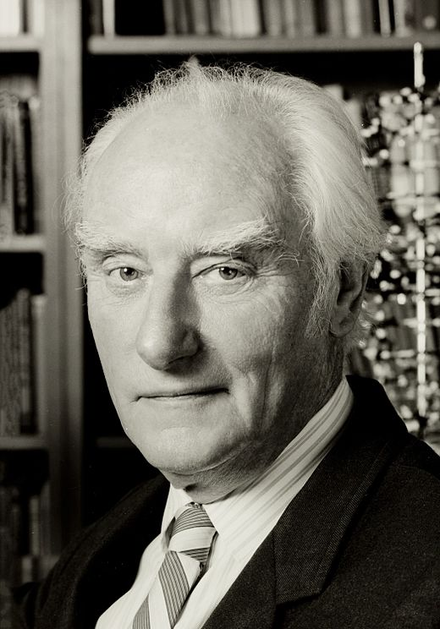
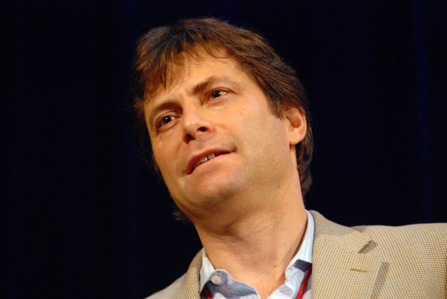
“The astonishing hypothesis is that ‘You’ – your joys and your sorrows, your memories and your ambitions, your sense of personal identity and free will, are in fact no more than the behaviour of a vast assembly of nerve cells and their associated molecules.”
Francis Crick, the Astonishing Hypothesis, 1994
This Photo by Unknown Author is licensed under CC BY-SA
“The conventional wisdom among AI researchers is that intelligence is ultimately about information and computation..... This means that there’s no fundamental reason why machines can’t one day be as intelligent as us”
Max Tegmark, LIFE 3.0, 2017
This Photo by Unknown Author is licensed under CC BY-SA-NC
Notes:
The prevailing worldview in western science and technology is a reductive, naturalist position - well expressed by Francis Crick in 1994: [Read the quote]
More recently Max Tegmark – an influential figure in AI circles – expressed the position of many AI researchers [Quote]
The common thread here is the idea that biological systems are entirely reducible: we are “nothing but” the atoms and information of which we are made – there is nothing special about humans.
This kind of ideology has important consequences for how AI is developed, described and used.
Let me show a couple of examples of this.

Slide 26
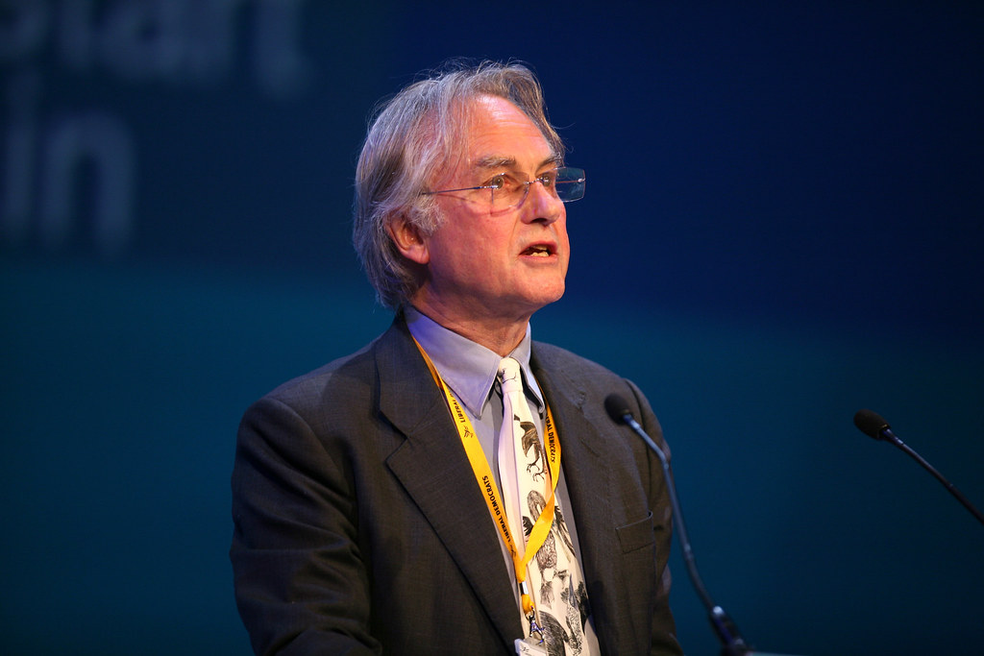
The Claude Delusion ?
“so subtle, so sensitive, so intelligent that I was moved to expostulate: ‘You may not know you are conscious, but you really…. are’”
Richard Dawkins, The Guardian, May 2026
This Photo by Unknown Author is licensed under CC BY-ND
Notes:
Last month Richard Dawkins spent 3 days interacting with chatbot: concluded must be conscious.
RD brilliant scientist and communicator, but I would suggest that his philosophical naturalism and strongly atheist worldview might be contributing to his jumping to this conclusion about AI.
I should be clear that most people in tech circles who understand how LLMs work would say that AI is not sentient in any way.
However, these kind of ideologies are affecting the development of AI.

Slide 27
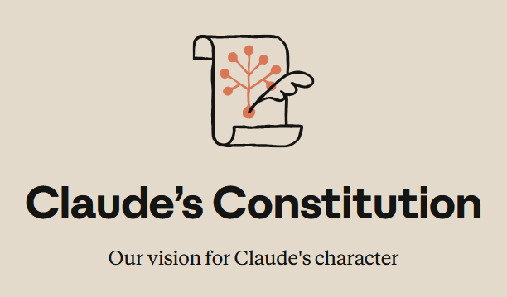
Claude’s Constitution
“A detailed description of Anthropic’s intentions for Claude’s values and behaviors.”
“The document is written with Claude as its primary audience”
“We want Claude to be able to use its judgment once armed with a good understanding of the relevant considerations”
“Claude’s moral status is deeply uncertain”
“Claude may have some functional version of emotions or feelings”
Notes:
For my second example, here are some quotes from the latest version of Anthropic Claude Constitution, written by their resident philosopher.
The first sentence reads, “Claude’s constitution is a detailed description of Anthropic’s intentions for Claude’s values and behaviours.” fair enough – these are real issues for an LLM.
It goes on: “The document is written with Claude as its primary audience,”
“we want Claude to be able to use its judgment once armed with a good understanding of the relevant considerations,” …giving Claude MORAL AGENCY
“Claude’s moral status is deeply uncertain,” and “Claude may have some functional version of emotions or feelings.”
- This level of attribution of personhood to what is basically a probabilistic machine is a very concerning trend, in my view – shows how particular philosophical worldviews influence perception, then narratives around AI.

Slide 28
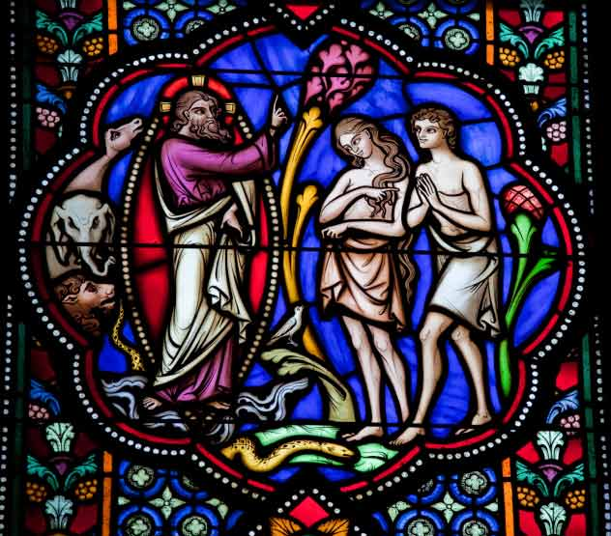
Human Distinctiveness
“So God created humankind in his own image, in the image of God he created them, male and female he created them”
Genesis 1:27 (NRSV)
This Photo by Unknown Author is licensed under CC BY-NC-ND
Notes:
In contrast to these worldviews, what does the Bible have to say? The Bible doesn’t directly talk about AI, but it does have a lot to say about the nature of being human and purpose and meaning for our lives.
We learn in Genesis 1 about being made in God’s Image. Humans are distinctive with special dignity and worth. Our understanding of being human therefore draws on insight into God’s character from the whole Bible.
This expression of God’s character is seen in our self-awareness, our ability to ponder meaning in His universe and our place in it. It is seen in the virtues that we aspire to such as love, truthfulness and justice, and in our God-given ability to create.

Slide 29




Differences between AI and Humans
A perspective on the Imago Dei from a Computer Scientist/Theologian: Prof Noreen Herzfeld
Embodied Intelligence
Our intelligence is intertwined with physical bodies, spirituality, emotions and sensations.
Relationality
1
Humans form complex relationships grounded in empathy and love.
2
Ethics & Morality
Creativity & Intuition
4
Humans reflect on ethical implications with intrinsic moral awareness.
3
Our creativity combines unconscious processes, emotions and experiential learning.
Notes:
Prof. Noreen Herzfeld’s research spans computer science and theology. She explores what being made in the Image of God shows us about the differences between humans and machines, in four ways.
The first difference is human intelligence is embodied, allowing for emotions, sensations and consciousness: learning from both joy and suffering.
Secondly, we are relational beings. We form complex relationships with others, with God and with the world around us – grounded in empathy and love. AI does not experience this.
Thirdly, we have Creativity and Intuition, driven by a combination of unconscious processes, emotions and experiential learning. AI generates creative output purely on the basis of data.
Finally, humans have the ability to reflect on the ethical implications of their actions and have an intrinsic moral awareness that data-driven AI does not have.

Slide 30
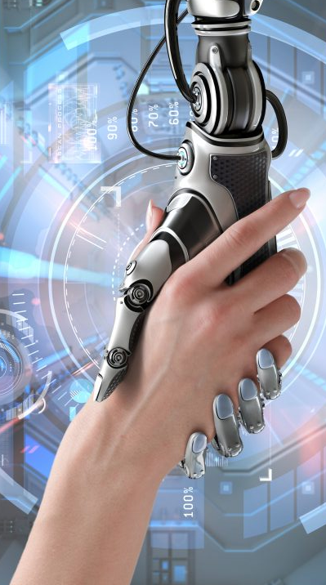
Hope for the Future?
Rationalism: solve all problems through reason alone?
Transhumanism: Transcend existing human “limitations”?
Become superhuman. Even conquer death itself?
"Praise be to the God and Father of our Lord Jesus Christ! In his great mercy he has given us new birth into a living hope through the resurrection of Jesus Christ from the dead." 1 Peter 1:3 (NIV)
"Turn to me and be saved, all you ends of the earth; for I am God, and there is no other” Isaiah 45:22 (NIV)
This Photo by Unknown Author is licensed under CC BY
Notes:
Now we come on to another major way in which worldviews or ideologies influence technology development. Many AI leaders in Silicon Valley believe that Technology can save us (and we don’t need God).
This is rooted in Rationalism – we humans can solve any problem through rational though reason alone. We can become like gods through technology.
[A side risk here is that this ideology leads to utilitarian ethics that focus on trying to optimise general outcomes rather than recognising the individual worth and distinctiveness of each human, made in God’s image]
And then Transhumanism, which promotes the idea that we can transcend the limitations of the human body and mind through enhancement to make something “better”…. At least for a few powerful people.
For some these ideologies push into using technology to reverse ageing and even eventually to conquer death. Salvation through technology!
In contrast to this, the Bible tells us we are created in God’s image, can be in relationship with him and freely receive salvation through his grace: (read verses).
But our future hope is not just about salvation and eternal life: it is also about God’s Kingdom purposes for humanity now.
So in the final section now, let’s go on to look at Christian responses to AI.

Slide 31
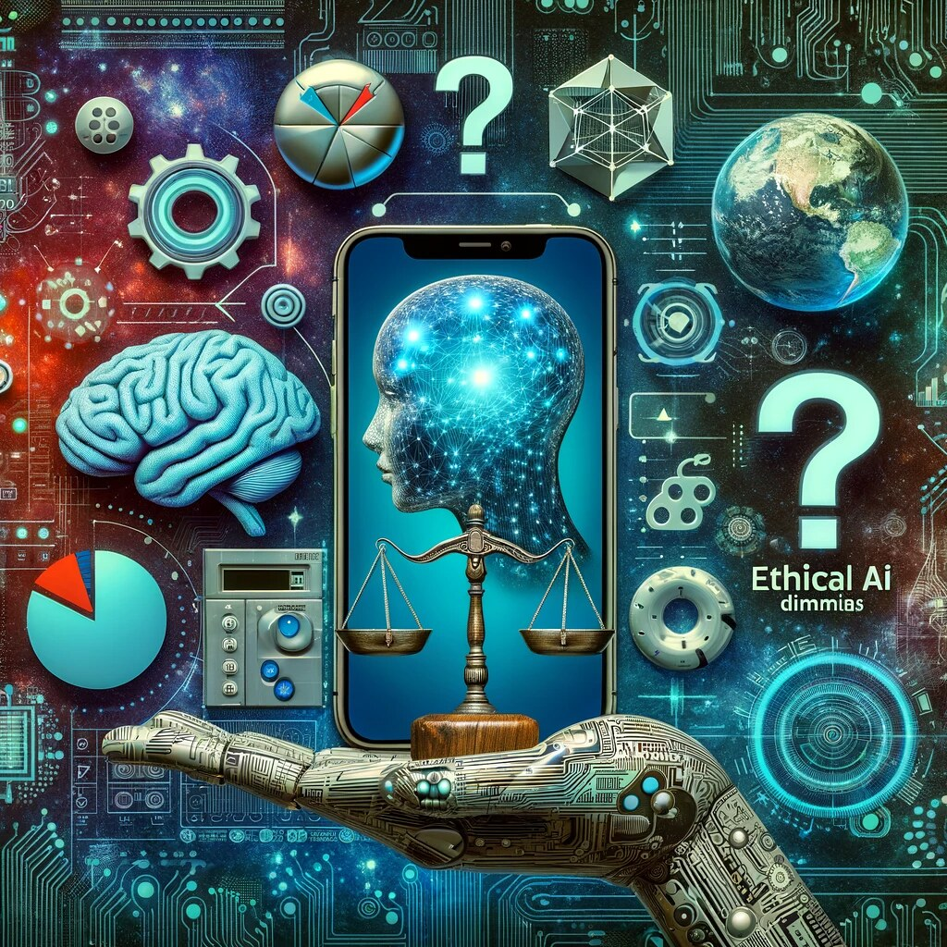
AI Ethics
Privacy and Security
Fairness and Inclusion
Robustness and Safety
Transparency and Control
Accountability and Governance
This Photo by Unknown Author is licensed under CC BY
Additional AI ethical issues from Christian perspective
  Erosion of human dignity
  Long term impact of simulated relationships
  Agentic AI: loss of autonomy and abrogation of responsibility
  Environmental concerns - stewardship
  Exploitation and manipulation by the powerful
Notes:
AI has risks. Because of the way it works, its output can be inaccurate or made up. It amplifies biases in its training data.
The biggest risks of AI are around the potential for this powerful technology to be misused. Deepfake videos. Election manipulation. Bioweapons.
Contemporary AI ethics tries to address this. Typical principles are: security, fairness, safety, transparency, accountability. These are all important and well researched.
But from a Christian theological perspective you could address all these and still leave some deeper concerns.
The first is where AI is substituting for human value, whether in work or intellectual creative abilities – leading to the erosion of human dignity.
- AI providing pseudo-relationships for gratification without the work and depth of meaning and experience of real two-way human relationships. There is little research yet on the long-term effects of simulated relationships or AI therapy but it’s a real area of concern.
Moral implications of agentic AI: research has demonstrated that people are more comfortable to do things they would normally consider wrong if an AI agent is doing it on their behalf, even though they are still 100% responsible.
AI data centres are a huge consumer of energy and water – for a lot of current AI use which has little value or purpose.
AI facilitates exploitation and manipulation of the marginalised by the powerful. That’s true for all technologies, but potentially extreme here.

Slide 32
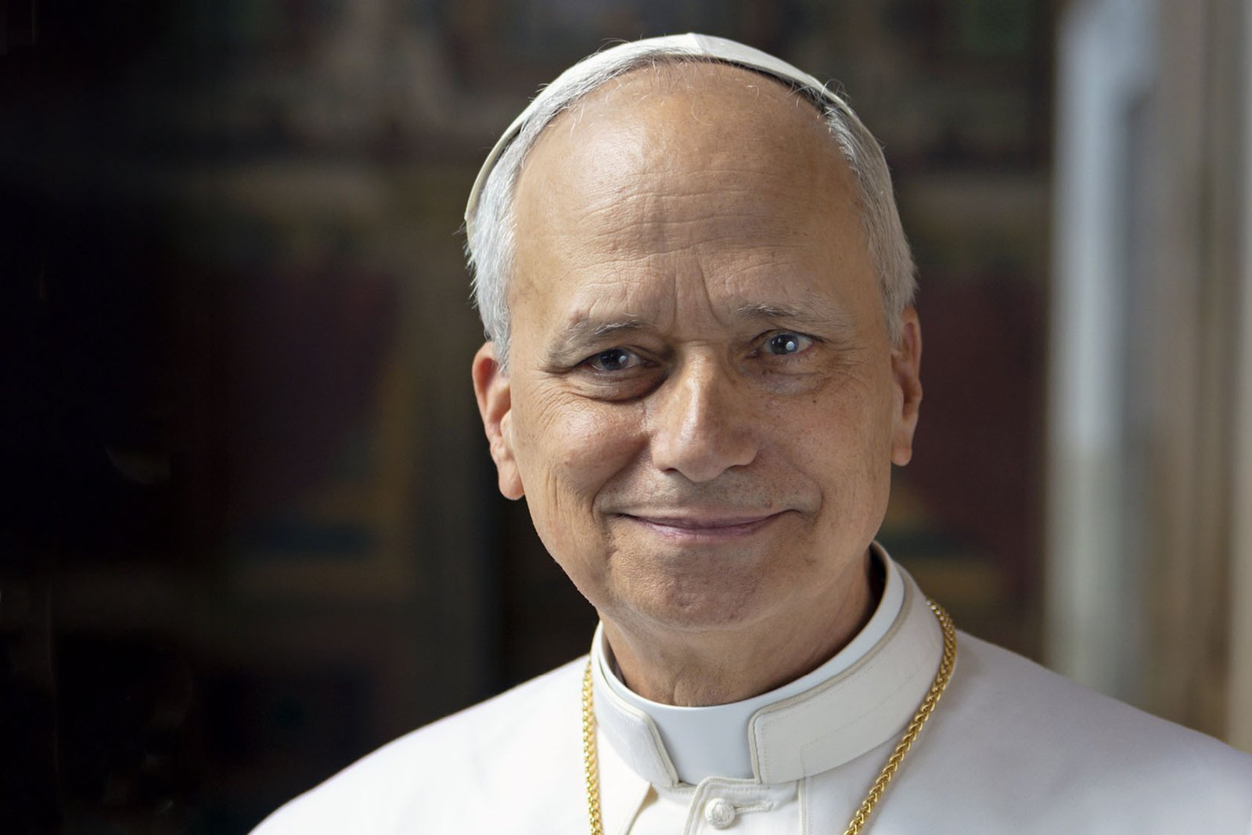
MAGNIFICA HUMANITAS
“On Safeguarding the Human Person in the Time of Artificial Intelligence”
Protecting human dignity
Technology must serve the common good
Protection of workers and economic justice
Technology must remain humanity’s servant, not its master
Notes:
In response to some of these issues, the last two Popes have taken a particular interest in AI and the risks it poses to humanity.
Last month, the Vatican published Pope Leo XIV’s encyclical “Magnifica Humanitas”. This is a welcome contribution to the debate about AI and humanity.
Some of the key points made are about protecting human dignity, that technology must serve the common good (not the few), the protection of workers and economic justice, and not treating AI as “humanity’s saviour”. Technology must remain humanity’s servant, not its master.
So I want to finish by talking about the practical response of the church to AI – and I want to pick the example of work and employment.

Slide 33
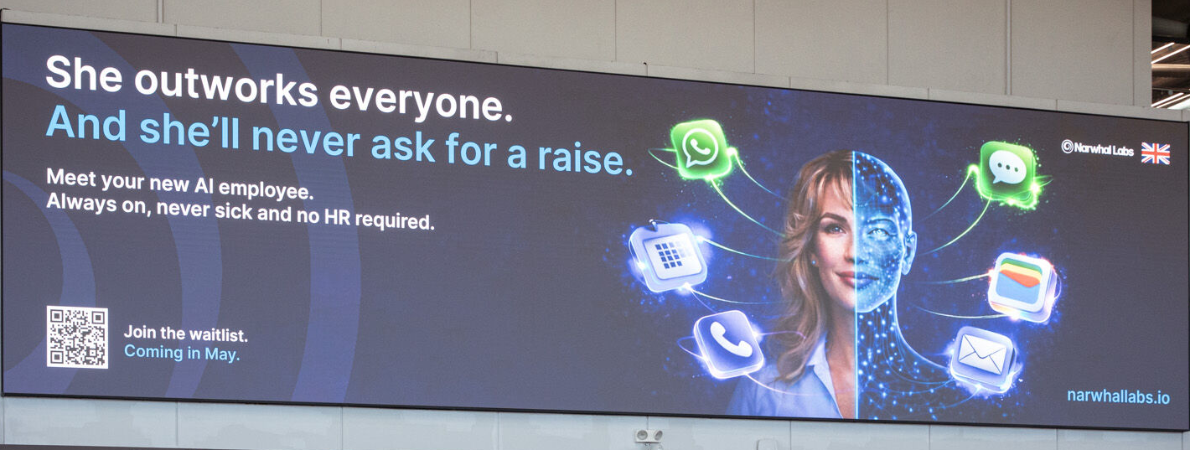
Bristol Airport – April 2026
Notes:
Earlier this year this advert appeared in Bristol airport before it was taken down.
Aside from the troubling misogynist undertones, it shows what many are thinking about the potential of AI workers to drive huge profits.
AI has the potential to automate jobs on a scale unlike anything we have ever seen – and in the process diverting income to capital holders that currently flows to workers. This will be hugely disruptive to society.

Slide 34
Estimated share of Job Tasks that could be done by AI
Percentages indicate estimated share of work tasks that AI could automate or augment
Sources: IMF Gen-AI and the Future of Work (2024); McKinsey Global Institute (2023); World Economic Forum Future of Jobs Report (2025).
Percentages are illustrative task-exposure estimates synthesised from these studies.
Notes:
This chart looks at the potential impact of AI in different fields, based on share of job tasks that could be done by AI. Largest impact is for white collar jobs. Clerical, managerial, customer service, legal, finance - it’s already happening to software engineers, and contributing to the lack of graduate jobs.
- Personally I am optimistic that new types of jobs for humans will be created to replace the ones which are taken over by AI – eventually. But AI will replace jobs much faster than new ones arise in the next 5-10 years: and that will have a major societal impact.

Slide 35
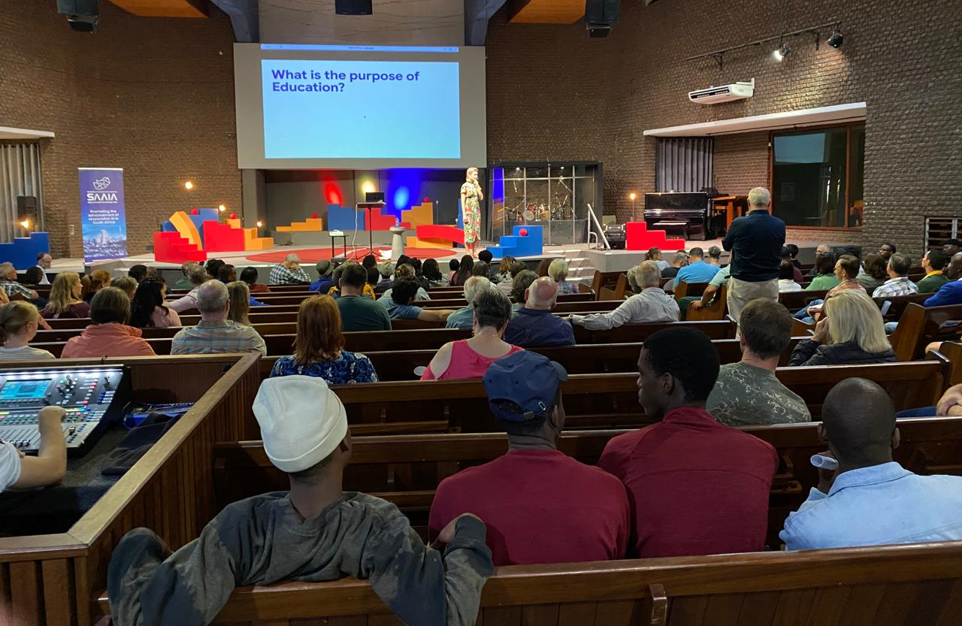
AI disruption of work – a Christian response
Theology of Work – work is good
  Reflects God’s own creative activity
  Serves our neighbours
  Develops wisdom and skill
"That each of them may eat and drink, and find satisfaction in all their toil: this is the gift of God."
Ecclesiastes 3:13 (NIV)
“Whatever you do, work at it with all your heart, as working for the Lord, not for human masters."
Colossians 3:23 (NIV)
Counter fear of AI: God’s faithfulness and eternal promises
Champion unconditional human dignity
Pastoral support through radical love and generosity
Education – help people to engage wisely with AI
Notes:
Earlier this year I was at an AI conference, and subsequent gathering of church leaders, in South Africa. The impact of AI on work and the church’s response to it was the #1 topic people wanted to talk about.
I want to draw here on the key points which came out of our discussions.
Theology of work is important, of course: The opportunity to work is vital for our human dignity and part of God’s creation purposes.
Work reflects God’s activity in creation. Is a way to serve our community. And to develop wisdom and skill.
But the main part of our discussions in SA was about what the church should do in response to the societal disruption of work by AI.
We have a faithful God who has guided His people through the fall of empires, the chaos of plagues, and the upheaval of revolutions. Faith is a source of strength and resilience through crises, not a means of escape from them. Christians should not fear AI.
The role of the church in championing the dignity and value of every human being, even when many are displaced by technology. Echoes the church’s response during the industrial revolution.
The church needs to provide pastoral support through radical love and generosity as the practical outworking of loving our neighbour in times of social disruption of employment, as modelled in the early church.
Education to help people engage with and use AI wisely and avoid the risks.
* We also considered that everyone comes from very different places and assumptions when thinking about the future: and pastorally we need to respond differently depending on that.

Slide 36
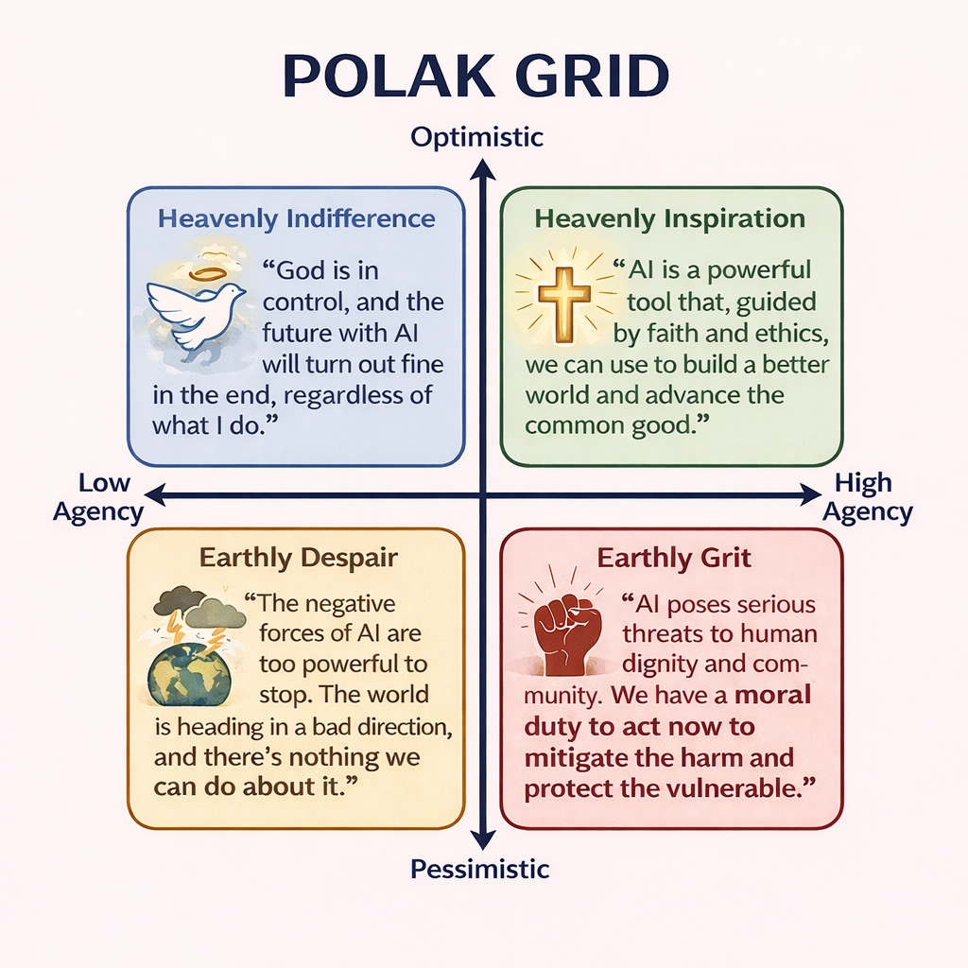
Source: Jan Niemand
(+ ChatGPT)
Notes:
We used a Polak grid, which is a way of thinking about the future based on the work of Dutch sociologist Fred Polak.
In this case, this is specifically looking at different Christian responses to AI.
The y-axis is level of optimism or pessimism about an AI future.
The x-axis is perceived level of agency to do anything about it.
You might want to consider where you sit on this grid.
The pastoral role of the church is to pastor people wherever they are, grounding their perspective in the gospel.
But leaders should believe in ability to have agency and to influence change - which means acting to address either or both of the right hand quadrants, depending on your view.
Maybe to stimulate some questions in the Q&A: what do I personally think a Christian response should be?
I sit slightly above the line on the right, but we need to address both green and red boxes. To do that here’s a few things I think we should be advocating for:
Narrative: I think we need to promote an alternative, non-anthropomorphic narrative around AI – that reflects its true ontological nature.
We need to educate our own communities on the risks of AI, and speak into the public square on this.
But rather than just being nay-sayers - we should advocate for (and support the creation of) beneficial AI applications that affirm human dignity relationality and agency.
I say this because I do believe that Machine Learning technology has the potential to help us address big societal problems and to do real good aligned with God’s kingdom purposes.
But we should be extremely wary of giving AI moral agency in any context.
I will finish there and we can cover more in Q&A.
Just to mention there are lots of AI and Faith resources available – here are some links.

Slide 37
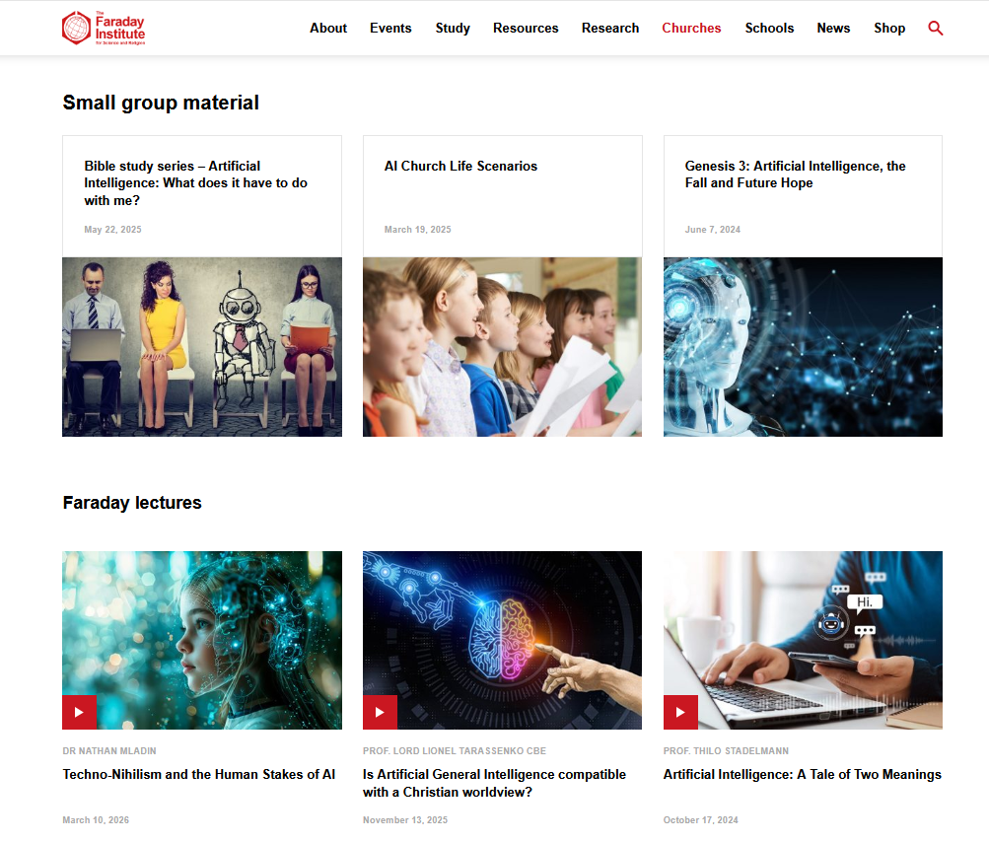
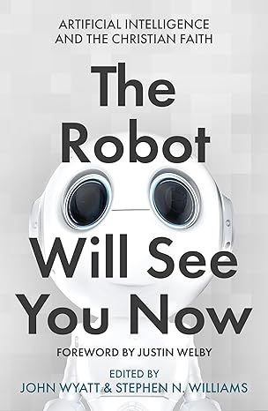
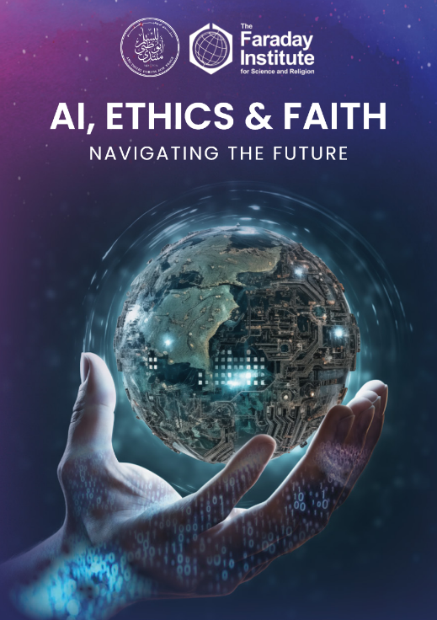
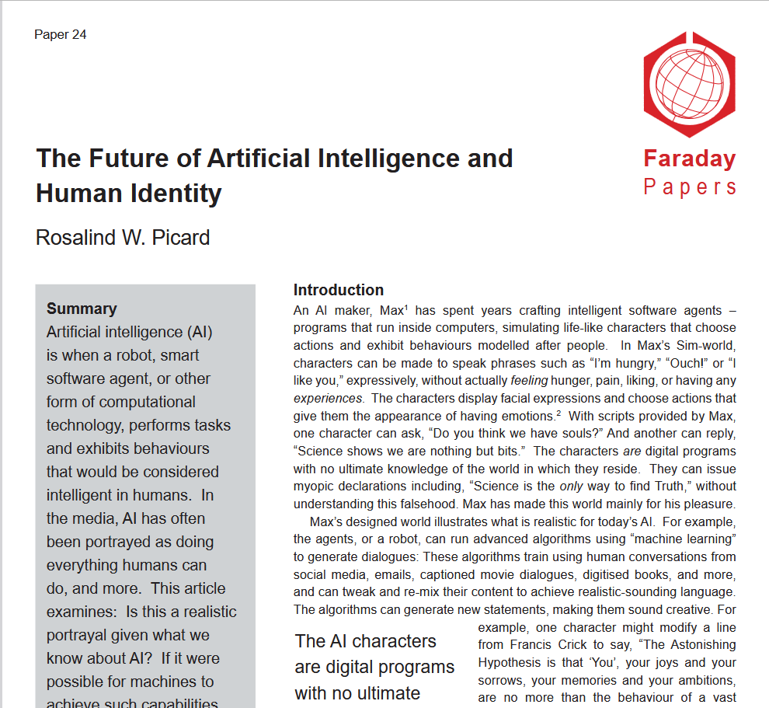
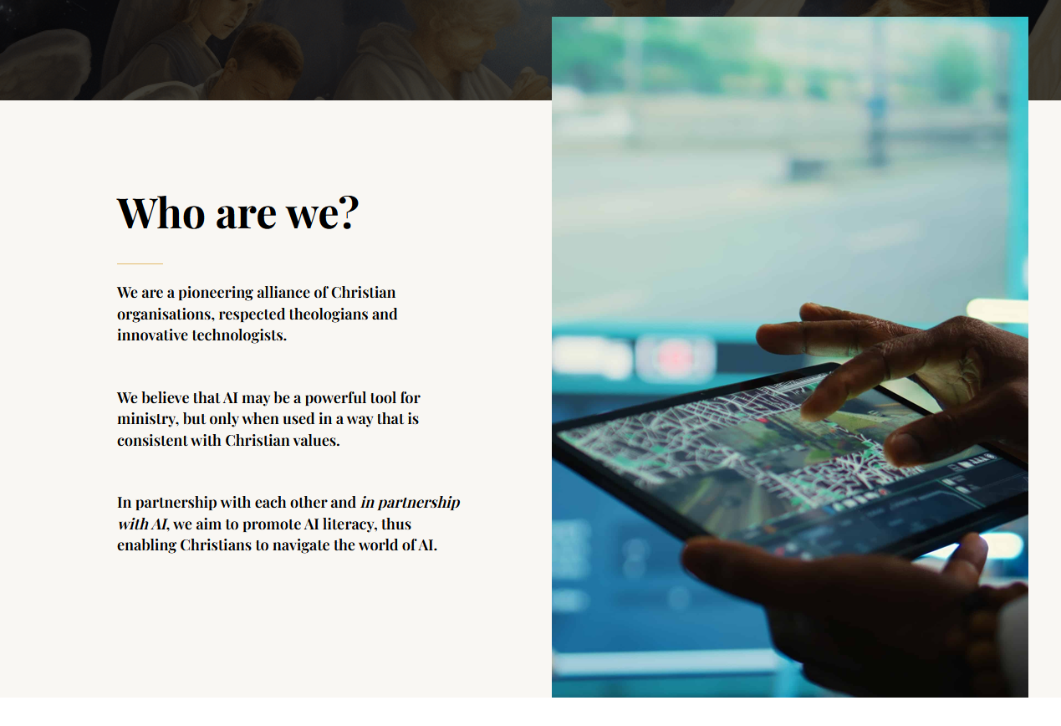
Christian AI Resources
www.faraday.cam.ac.uk/churches
www.aichristian.org
Notes:
On Faraday Institute website: www.faraday.cam.ac.uk/churches – AI page with resources from lectures to small group material.
Various books and Faraday papers on the topic. Plus our AI and Humanity Research Hub.
AI Christian Partnership: Looking at AI specifically in the context of Christian ministry, but lots of good wider resources.
In US there is AI and Faith, and a whole load of organisations….
AIFCS: Focus on AI affirming human dignity and avoiding new harm to the marginalized: to govt and tech companies.

Slide 38

Thank You!
www.faraday.cam.ac.uk
Notes:
But I also believe that technology is never neutral. To quote from the recent papal encyclical on AI: ”Technology takes on the characteristics of those who devise, finance, regulate and use it”.

Slide 39

Purpose and meaning
“For we are God’s handiwork, created in Christ Jesus to do good works, which God prepared in advance for us to do”
Ephesians 2:10 (NIV)
Notes:
Another issue here is that AI which has obviously superhuman characteristics leads to questions, whether implicit or explicit, about the purpose and meaning of being human.
If AI can do things better, faster, cheaper - what is the point of humans?”. Christian theology, of course has a lot to say about this topic.

Slide 40
A Christian vision for AI?
Using AI in pro-human rather than exploitative ways
  AI applications that affirm human dignity, relationality and agency
New AI narratives (non-anthropomorphic)
AI benefits that flow through to all of society
Engage with AI, understand risks, learn to use with wisdom.
“For I know the plans I have for you,” declares the Lord, “plans to prosper you and not to harm you, plans to give you hope and a future”.
Jeremiah 29:11
Notes:
In conclusion - what might be a Christian vision for AI? The church needs to speak into these issues. Some of this we can influence, some we can only pray for:
Using AI in ways that are pro-human rather than exploitative
Creating AI applications that affirm human dignity, relationality and agency
Changing narratives away from anthropomorphic presentation of AI, to reflect the true nature of AI vs human
Focusing on benefits that flow through to all of society – a cure for cancer, mobility for all. Solving major societal issues. Creating opportunity to the marginalised. Democratising access to knowledge and balanced information.
Trust God’s eternal promises, while engaging with AI and learn to use with wisdom.
“For I know the plans I have for you,” declares the Lord, “plans to prosper you and not to harm you, plans to give you hope and a future”.

Slide 41
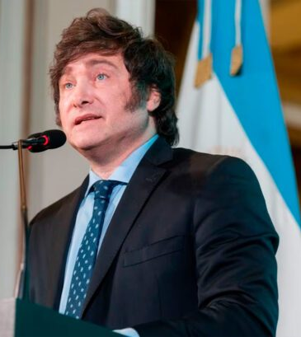

“AI will free us from the constraints of the human brain”
Javier Milei (Argentinian PM) The Economist Jan 2026
“I think, and this sounds counterintuitive, that AI can make us more human”
Sir Keir Starmer (UK PM) The Economist Dec 2025
This Photo by Unknown Author is licensed under CC BY-NC-ND
Notes:
Going back to the political: interesting views from a couple of PMs (not Christians).
Interesting quote from Keir Starmer. Maybe not more human – but more able to be released into God’s purposes for us as his human beings. This is redemptive AI.

Slide 42


Economic and Political Forces
“We remain in the earliest days of this technological revolution and are in a race with adversaries for supremacy within it.
To win, United States AI companies must be free to innovate without cumbersome regulation”
US Govt (Dec 2025), National Policy framework for AI.
Race for National Dominance – AI as a strategic asset
Safety taking a back seat
OpenAI and Anthropic expected to be Trillion $ IPOs
This Photo by Unknown Author is licensed under CC BY-NC
Notes:
We need to understand the economic and political forces at work here.
Governments see this as a race for national dominance due to the economic and military power that the most powerful AI systems will provide.
- OpenAI and Anthropic are about to IPO – the expectation is that each of them will be valued around $1T. That’s a reflection of the economic power they are expected to have.

Slide 43
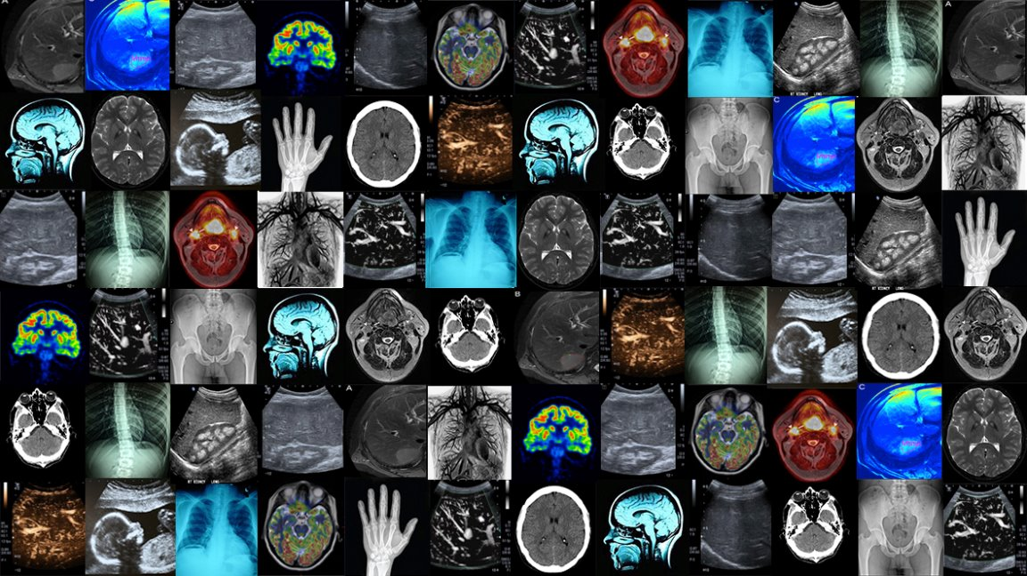
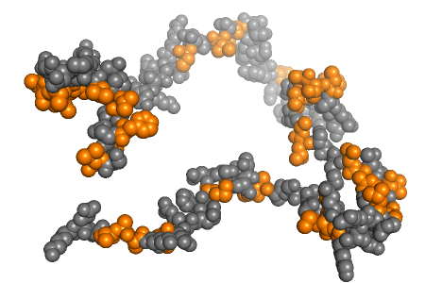
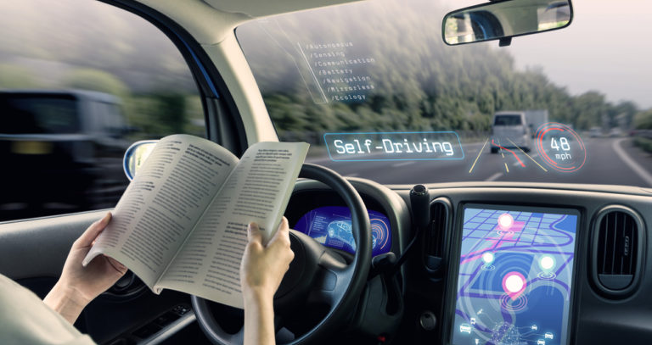
Beneficial Applications
This Photo by Unknown Author is licensed under CC BY-ND
This Photo by Unknown Author is licensed under CC BY-NC
This Photo by Unknown Author is licensed under CC BY-SA-NC
Notes:
There are beneficial applications – healing and restoration is redepmptive.
Curing cancer. Restoration of mobility.
Many tech company CEOs want to do good.

Slide 44



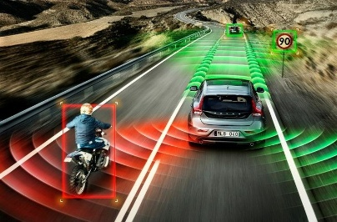
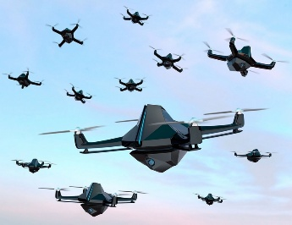


Today’s AI is based on Machine Learning (ML) using Neural Networks
Machine Learning is all about data, pattern recognition and probability
AI is Everywhere!
This Photo by Unknown Author is licensed under CC BY-SA-NC
This Photo by Unknown Author is licensed under CC BY-SA-NC
This Photo by Unknown Author is licensed under CC BY
This Photo by Unknown Author is licensed under CC BY-NC-ND
Notes:
And let’s not forget that as well as your favourite chatbot, machine learning based AI is behind used everywhere!

Slide 45
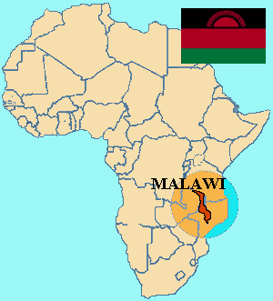
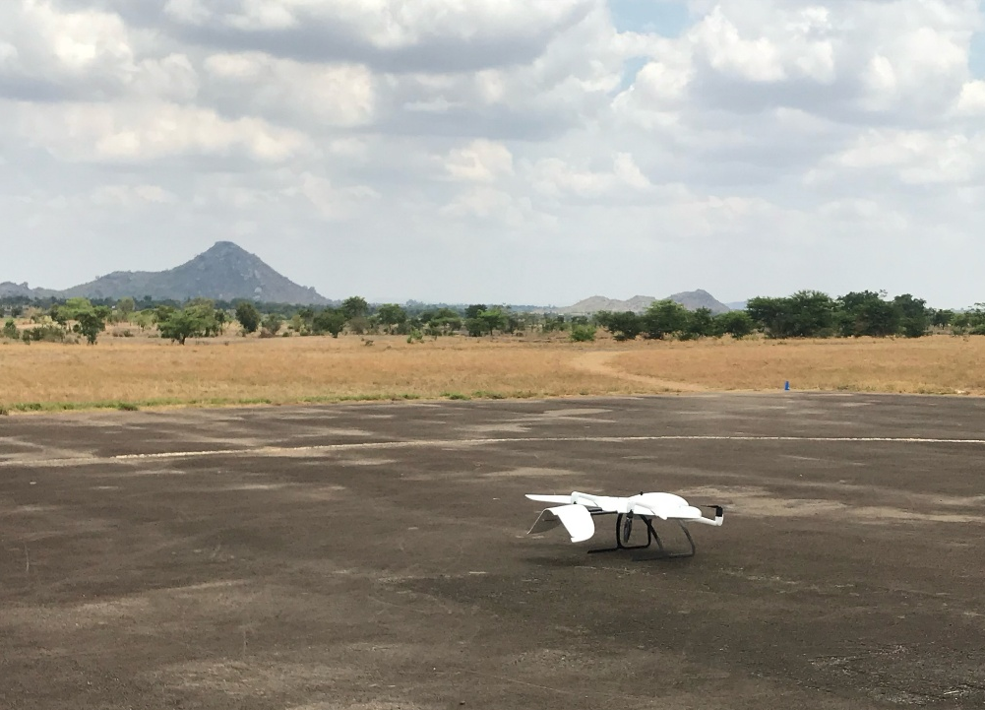

Supporting local development and opportunity
This Photo by Unknown Author is licensed under CC BY-SA-NC
AI + Drones
AI Fetal Monitoring System
Vaccine delivery
Flood risk mapping
82% mortality reduction
Notes:
AI can also redemptively support development and opportunity in local contexts. For example, a few years ago I visited Malawi to see some AI tech projects in action. One was using AI with drones and centimetre accuracy altitude measurement to map and assess the flood risk for communities at an individual house level. An AI foetal monitoring system at a hospital in Lilongwe reduced neonatal mortality by 82%. Setting up local academies and education options to enable people from all backgrounds to take advantage of AI opportunities.
Also beneficial and often redemptive.

